Slide 1



Operational Guidance for the implementation of the CRF
Meeting of PAP/RAC Focal Points,
Split, Croatia, 8-9 May 2019
Daniela Addis
Environment & Sea Law Firm
Emiliano Ramieri
Thetis S.p.A.
Yves Henocque
Consultant

Slide 2
CRF methodological guidance
The present methodological guidance aims to support the implementation of the ICZM Protocol at regional and sub-regional levels (with possible replication at lower scale), within the CRF, towards the achievement of EcAp EOs, in a coordinated and integrated manner with the UNEP/MAP-Barcelona Convention System, and in light with the relevant international instruments.

Slide 3
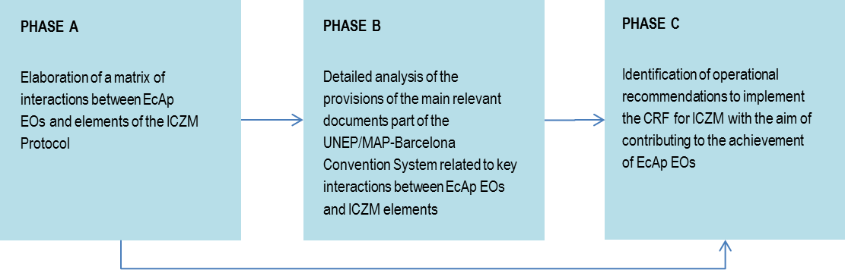
Phases of the methodological guidance
A specific interactive IT platform should be functional designed and therefore set up as an operational tool to support the implementation of the process, using existing mechanisms.
3
Slide numbers to be added
as shown alongside

Slide 4
PHASE A - Matrix of interactions
The matrix of interactions is developed and should be directly utilized as an assessment tool supporting decision-making mechanisms at the different levels (regional, sub-regional, national, sub-national): the identification of the spatial and temporal (short, medium and long-term) scales is therefore an essential initial step of the overall analysis (from Phase A to Phase C), including the elaboration of the matrix of interactions.
4
Slide numbers to be added
as shown alongside

Slide 5
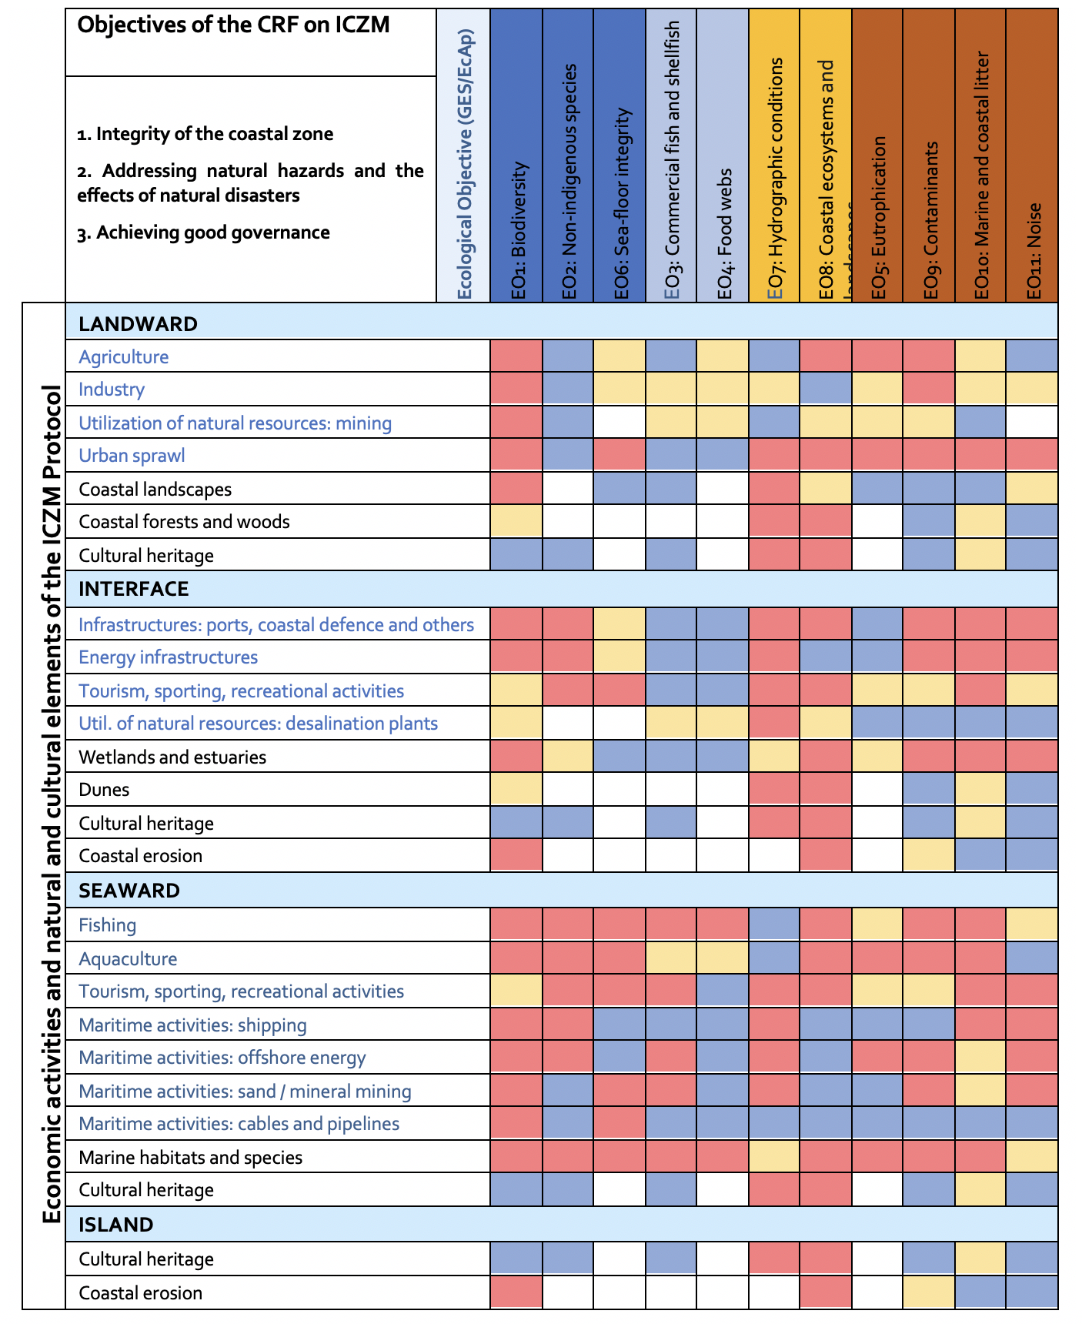
PHASE A - Matrix of interactions
Matrix refers to the regional scale of analysis.
Dynamic instrument, whose values depend on the scale, temporal dimension and specific characteristics of the area of analysis.
Different tools can be used to support the matrix updating (e.g. MEDPOL based on DPSIR approach).
5
Slide numbers to be added
as shown alongside

Slide 6
Phase B – Analysis of provisions of main documents
The initial part of Phase B: identification of the most relevant interactions between EcAp EOs and elements of the ICZM Protocol, based on the analysis performed in Phase A.
Different approaches and methods can be applied to identify such interactions, which also depends on the specific scale of analysis (regional, sub-regional, national, sub-national).
The second part of Phase B provides a detailed analysis of the provisions of the main relevant documents part of the UNEP/MAP-Barcelona Convention System related to key interactions between EcAp EOs and the elements of the ICZM Protocol previously identified.
6
Slide numbers to be added
as shown alongside

Slide 7
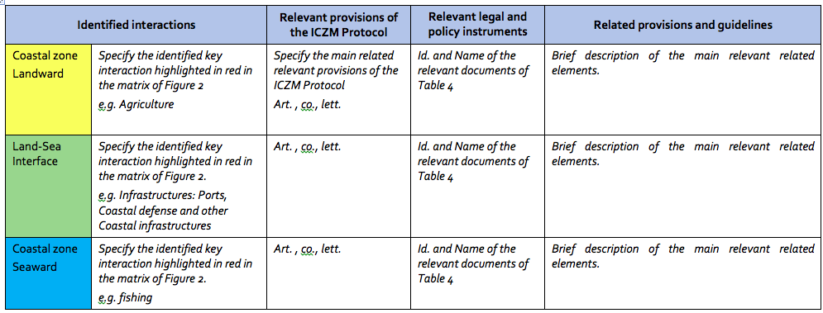
Phase B – Analysis of provisions of main documents
Main goals: (i) Provide a coherent implementation of ICZM in the Mediterranean and the related policy documents of the UNEP/MAP-Barcelona Convention, in light of EcAp EOs; (ii) Provide a sort of “manual” to be consulted by users according to their specific focus.
7
Slide numbers to be added
as shown alongside
Notes:
Table template for the analysis of main documents for key interactions related to pressure and state/impacts elements of the ICZM Protocol
You may find the result of Phase B analysis in Appendix 1 (the long table).

Slide 8
Phase C - Identification of operational recommendations
Phase C aims at identifying a set of operational recommendations which shall be calibrated in relation with the geographical coverage and the time at stake, as well as cumulative impact integration rules, regularly updated.
Operational recommendations are strictly dependent on the spatial and temporal scale of analysis, to be identified at the beginning of the methodological process.
8
Slide numbers to be added
as shown alongside

Slide 9
Phase C - Identification of operational recommendations
Recommendations should be:
Focused on the elements of the ICZM Protocol which show most relevant interactions with the EcAp EOs (priority interactions), according to the previous phases and for which policy documents are analysed in Phase B.
Developed in relation with the first two main objectives of the CRF on ICZM (Coastal zone integrity; Natural hazards) provided the 3rd one (governance) is cross-cutting the two others.
It is recommended to cluster elements (activities and natural and cultural elements), e.g. for coastal and maritime activities and natural and cultural elements considered by the ICZM Protocol.
9
Notes:
Developed in relation with the first two main objectives of the CRF on ICZM:
Ensure sustainable development and integrity of the coastal zone, its ecosystems and related services and landscapes, in such a way to:
address the process through which relevant sectors can ensure sustainable use of natural resources; and
improve protection of coastal and marine ecosystems and the preservation of related ecosystem services.
Address natural hazards and the effects of natural disasters - in particular coastal erosion and other climate-related impacts - thus contributing to reduce, as much as possible, the factors of risks, which can prevent the achievement of the EcAp EOs.

Slide 10
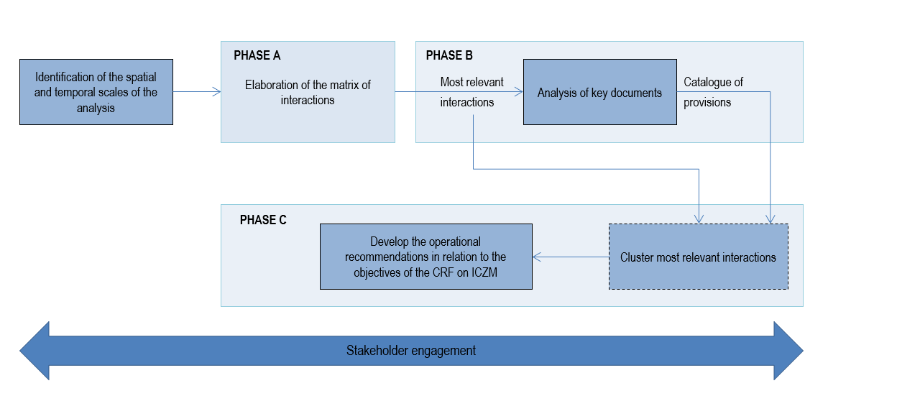
Step-wise process towards development of the operational recommendations
10

Slide 11
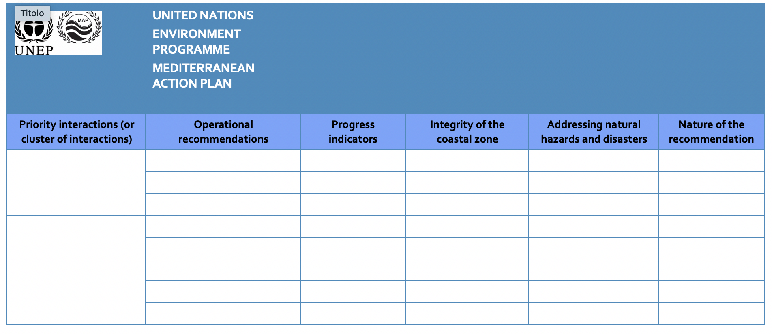
Template for the identification of operational recommendations
11

Slide 12


Thank you
Avv. Daniela Addis
Environment&Sea Law Firm
Piazza Dell’Oro 3 – 00186 Rome IT
Tel. +39 333 500 3493
daniela.addis@gmail.com – daniela.addis@me.com
..

